Slide 1
Introduction to
pre-commit
A framework for managing and maintaining
multi-language pre-commit hooks.
@mozillazg

Slide 2
Problem
Too many dirty commits like “fix pep8”
Reviewer unhappy
CI busy
Commit history become ugly

Slide 3
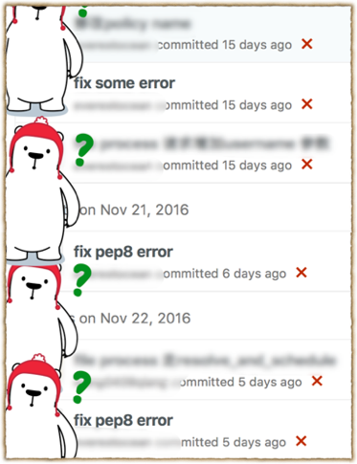
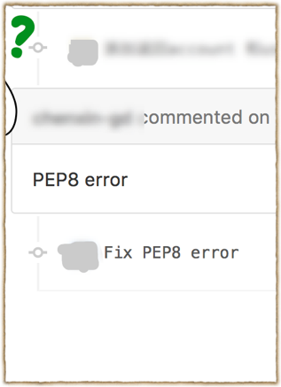

Slide 4
Solution
We need a tool.
Discover error before CI
Discover error before push

Slide 5
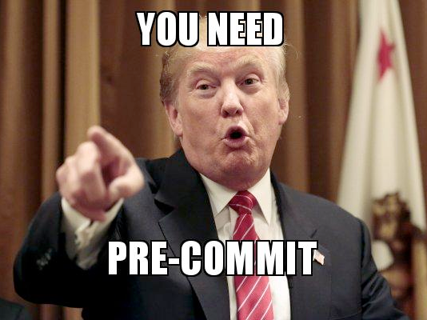

Slide 6
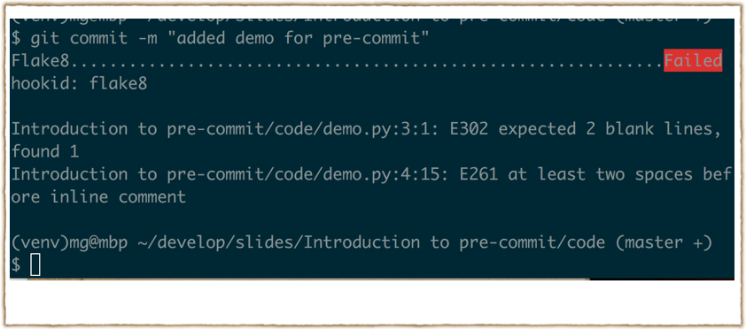

Slide 7
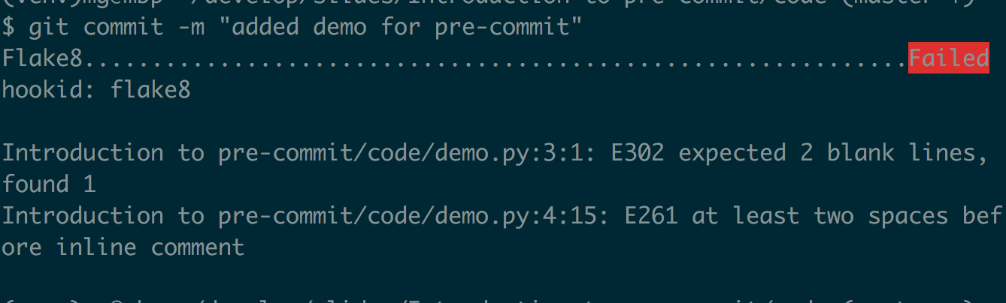

Slide 8
pre-commit
pip install pre-commit
vim .pre-commit-config.yaml
pre-commit install

Slide 9
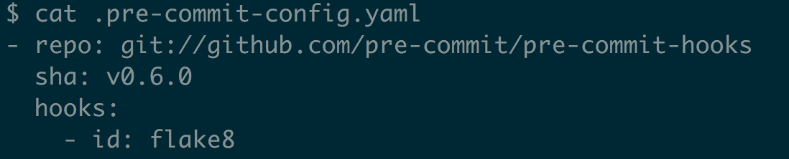
.pre-commit-config.yaml

Slide 10
More
http://pre-commit.com

Slide 11
Thank You!

